Slide 1

Welcome to COMP2001 Information Management and Retrieval
Martin Read

Slide 2
Outline of session
Types of Data-Driven Applications
Database Coding patterns
Entity Framework

Slide 3
Types of Data Driven Applications
What types of applications do you use on a regular basis?
Daily interaction with social media?
Daily interaction with email?
Consider the way you interact
Mobile App?
Website?
Think back to the architectures and patterns
Notes:
Have a poll.

Slide 4
Full stack
Client/Server architecture
Whole application covers a stack
Backend = database
Front end = user interface
Full stack developers in demand, but it is not feasible to know ”everything” there is to know about it all
Myriad of technologies to choose from
Pick a stack you like and master it
Learnt about HTML/CSS/Javascript in year 1
Touched a little on PHP – server-side
Predominantly the ”front-end”
Different layers can use different languages
Notes:
The backend development usually refers to writing code for the server-side, handling data, providing API’s, managing security, deployment etc.
Front end development refers to writing code for the client side, maybe web clients running in users browsers, working on the user interface, presentation logic, browser combability, performance, responsiveness etc.
Backend and front end do not usually share code. They are likely to be written in different languages, run on different types of machines and possibly be in different geographical locations. They communicate via the HTTP client-server architecture.
The intended user for the backend is the computer system, the frontend is for humans.

Slide 5
Full Stack
Cloud
Self
Provider
Hosting
Where?
What OS?
Application Stack?
Web application
The bit you create..
Data Centre?
Server farm?
Dedicated Server?
DB
Language
Data
Design
Markup
Coding
HTML
CSS
PHP
.NET
Javascript

Slide 6
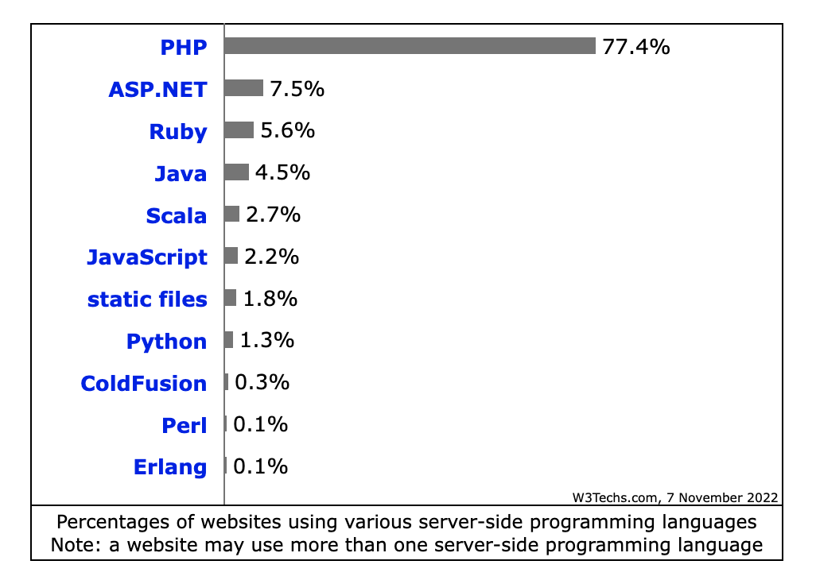
Coding languages
This is why we are concentrating on ASP.NET here
The principles will help you transfer to any of the others
Recommended book “Seven Languages in Seven Weeks” Bruce A Tate – in the library

Slide 7
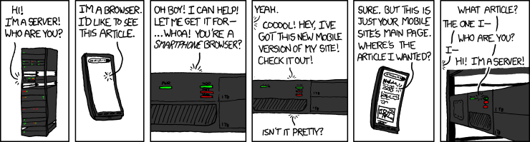
HTTP
HTTP is stateless
No shared memory, it does not remember what has gone before
So you need to code accordingly
More on that later!

Slide 8
Front end
Users are not homogeneous
Variety of access methods and devices affects their experience of using your software
Design therefore must carefully consider the flow of work
Interface must help the user to be effective and avoid mistakes
Shift from traditional, server-centric architecture to single page application, client-server architecture
Eg move away from everything running on server

Slide 9
Planning your application
Consider from the user perspective
Whole point of Agile Software Development methodology
Map out a route that your user takes to achieve some thing.
Use Storyboarding to think about what the user encounters
To represent an overall “map” of your application
Consider how each aspect of your “route” needs to be created
Think about classes
How the classes interact with each other

Slide 10
Activity
Spend ten minutes creating a route for a user for the following user story
As a customer I wish to order a pizza
On a piece of paper sketch out what you think the user should see on each screen
10

Slide 11
Code design
Consider the language in use
ASP.NET uses C# as “code behind”
It is compiled
Takes a while on first loading
ASP.NET Core is now open source and cross platform
ASP.NET has many different projects – Tim Corey gives a good discussion on these here -https://www.youtube.com/watch?v=YhojOiGjGvQ
Concepts are the same irrespective of language. Try and think at a meta-level and then look up syntax

Slide 12
Data Access Patterns
Add to what you are doing in COMP2000
Some basics for our development
KISS – do not overcomplicate things
DRY – Use abstraction to pull out the common things and put in one location
YAGNI – Do not put in things that have not been asked for.
SOC – Encapsulate unique behaviour and data that can be used by other classes. Separate things out so that you can increase code reuse, maintenance and testability

Slide 13
Anti-patterns
An approach that is in common usage that appears to solve the problem, but really creates a situation with negative consequences
ASP.NET Web Forms is one such thing
Drag and drop is good for prototyping
But it pulls you into an Anti-pattern because it all gets mixed up in one page
The antidote is to layer your application
MVC

Slide 14
Data Access Objects/Repository
Two data access strategies to help organise the data layer
Repository is an in-memory collection with a public interface
Hides all the connections of the database
Acts at higher level than DAO (uses DAO)
Data Access Objects
Separates different elements of data access layer (DAL)
DAL solely responsible for talking to data store
Includes all CRUD operations

Slide 15
Repository pattern
Is a collection
Holds entities and can filter and return entities back
Is testable
Primary benefit is that the repository abstracts the storage mechanism away for the collection
It does not create them
Works between the data layer and the business layer
Often used with Unit of Work pattern
Presentation layer
Business layer
Data layer

Slide 16
Data Access Objects
One object for each table
One to one match
Useful for swapping around data sources – enable loose coupling
ADO.NET is not type safe and difficult to maintain
ORM – Object Relational Mapping is a framework to do it for you
ORM frameworks persist objects to the database and retrieve them via ORM API without using SQL
Entity Framework

Slide 17
Activity
COMP1004 showed you UML for class diagrams
Consider the user story
As a customer I wish to order a pizza
Draw the UML for your class diagram for the important elements here
Pizza
Customer
Now think about what goes into the class diagram for a repository for pizza
10

Slide 18
Unit of Work
Unit of Work pattern maintains a list of objects that have been changed in the course of a transaction
Adding, removing or updating
Coordinates the persistence and flags any concurrency problems
Helps to ensure data integrity
Works with transactions
So can include transactions in this layer as well as in db

Slide 19
Frameworks – Microsoft EF
Entity Framework is Microsoft ORM (Object Relational Mapping)
Scaffolding means you do not have to write all the classes and methods yourself
But if you are no sure what it is doing, can be very confusing
Developer interacts with the model to access collections
Remember repository pattern
LINQ – Language Integrated Query
Integrated into C# to offer a query interface to the collections
Two workflows : Database First or Code First

Slide 20

Frameworks : Laravel for PHP
ORM is Eloquent
Similar approach to EF
Each table has corresponding model
https://laravel.com/docs/5.7/eloquent

Slide 21

Any Question?

